Slide 1
AI Champions Bootcamp Agent-based Analyser for Technical and Regulatory Requirements Checks
Pong Woon Wei, Senior Manager, BCA (Lead)
Unni Krishnan AMBADY, Senior Lecturer, BCAA
Adapted From Data Literacy ePrimer – Module 5

Slide 2
Agent-based Analyser for Technical and Regulatory Requirements Checks
prepared by PONG Woon Wei, Senior Manager, BCA (Lead)

Slide 3


Problem Statement: The Problem
The construction industry still relies heavily on manual checks to verify design intent and technical drawings against building specifications and regulatory requirements (e.g., BCA, SCDF, etc.).
Stakeholders with diverse backgrounds and expertise often struggle to navigate the complex tools and requirements needed for these checks.
With hundreds of projects initiated annually, these inefficiencies compound, leading to time-consuming processes and impacting manpower allocation.
The key question is:
How can we simplify and automate repetitive checks, reduce non-compliance risks, and improve workflows to ease the work burden on project stakeholders?
https://launchpad.gov.sg/ideathon/8adea89f-b8bd-4015-b9b8-4ed956b7a60a/ideas/58549471-d222-41a5-aef4-ba2cd0d837d5

Slide 4

Proposed Solution
The proposed solution converts user-provided project data and requirements (e.g., technical drawings, building specifications, standards, and regulations) into an accessible tabulated structure, covering five key areas:
1. Intent: Extract measurable figures from technical drawings, documents, etc.
2. Requirements: Extract measurable figures from regulatory requirements
3. Checks: Compare design intent against requirements for non-compliances.
4. Recommend: Provide suggestions based on the most stringent requirements.
5. Validate: Cross-check online data for common practices and requirements.
This enables non-technical stakeholders to easily analyze and ensure project conformance. The system automates data processing and validation using Python packages, Google Gemini LLM models as AI agents assigned to tasks like extracting, parsing, comparing user-provided information, and cross-reference design intent with regulatory requirements, generate reports, validate using available online data resources, and respond to natural language queries to recommend the most stringent design criteria.
A Proof of Concept (PoC) will demonstrate the solution’s feasibility using a common component, such as windows and/or doors, scalable to other components.
https://launchpad.gov.sg/ideathon/8adea89f-b8bd-4015-b9b8-4ed956b7a60a/ideas/58549471-d222-41a5-aef4-ba2cd0d837d5

Slide 5

Impact
This solution will streamline repetitive checks, reduce reliance on complex tools and manual processes, and mitigate non-compliance risks for project stakeholders.
With over 12,000 projects’ submissions expected annually, automating design and regulatory compliance checks will significantly enhance efficiency and accuracy for regulatory bodies and industry practitioners.
https://launchpad.gov.sg/ideathon/8adea89f-b8bd-4015-b9b8-4ed956b7a60a/ideas/58549471-d222-41a5-aef4-ba2cd0d837d5

Slide 6

Stakeholders & Users
Industry practitioners, including Qualified Persons (QPs), main contractors, suppliers, specialists, and public agency officers, will benefit from automated analysis, checks, and increased productivity in ensuring design requirements and regulatory compliance.
https://launchpad.gov.sg/ideathon/8adea89f-b8bd-4015-b9b8-4ed956b7a60a/ideas/58549471-d222-41a5-aef4-ba2cd0d837d5

Slide 7

Available Data and Samples
The project is using publicly available regulatory requirements, such as BCA approved documents and the SCDF Fire Code 2023, specifically focusing on Chapter 4 fire safety requirements for access openings.
These standards are essential for ensuring compliance needs for all building projects.
To better scope down the workload, the project is using a window schedule, captured as jpeg and used as practical data samples.
These sources provide a foundation for testing the automated parsing and compliance-checking capabilities of the system, helping users validate their building designs against recognized regulatory requirements efficiently.
https://launchpad.gov.sg/ideathon/8adea89f-b8bd-4015-b9b8-4ed956b7a60a/ideas/58549471-d222-41a5-aef4-ba2cd0d837d5

Slide 8

Data Classification
Officially (Open) / non-sensitive
https://launchpad.gov.sg/ideathon/8adea89f-b8bd-4015-b9b8-4ed956b7a60a/ideas/58549471-d222-41a5-aef4-ba2cd0d837d5

Slide 9

Lines Of Inquiry
Hypotheses and Assumptions
AI Feasibility: The current AI models trained is able to extract, parse, clean and structure the data from PDF and image files.
Compliance Automation: With multi AI agent-based workflow, the process can be effectively streamlined on data processing for non-compliances checks.
Validation Approach
Testing & Comparison: Using a third party AI Agent of different model to compare AI-extracted data and recommendations, and having manual checks for accuracy.
User Study & Scalability: Through completed AI Hackathons with trade association chambers, and key vendors e.g. SIA/YAL and Google TrailBlazer programme, we have gained better understanding of the users’ problem statements and needs for potential AI Agentic workflow and automated solutions to be scaled.

Slide 10
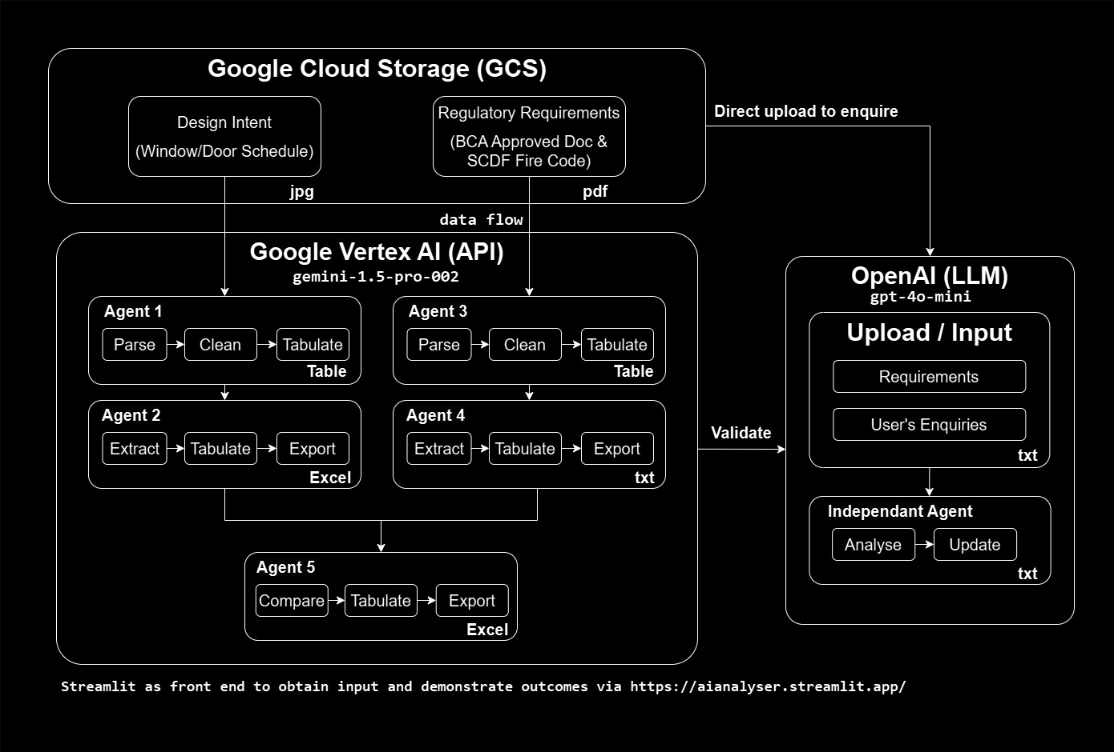
Methodology (Flow Chart)
https://github.com/integrations-space/streamlit/blob/main/pictures/WorkflowDiagram.jpg

Slide 11
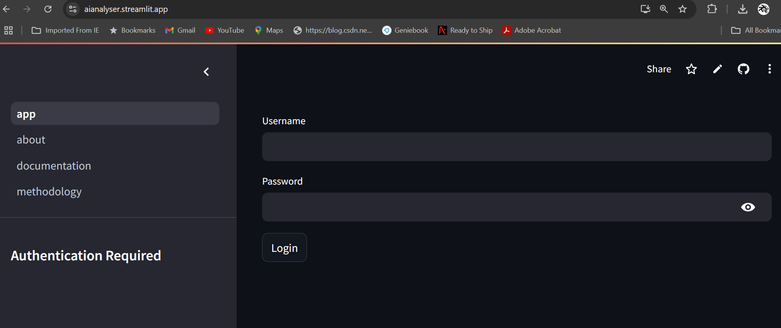
Mock Up
https://aianalyser.streamlit.app/
Username: ants Password: abc2024

Slide 12
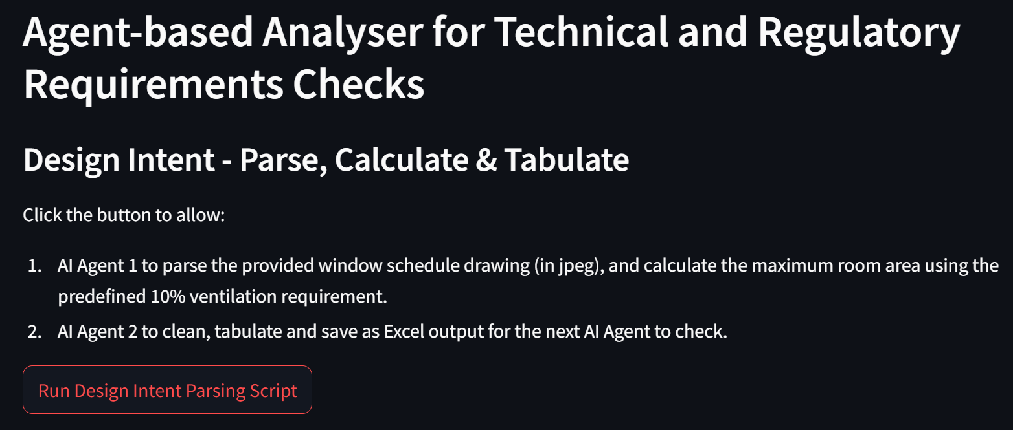
Mock Up
https://aianalyser.streamlit.app/

Slide 13
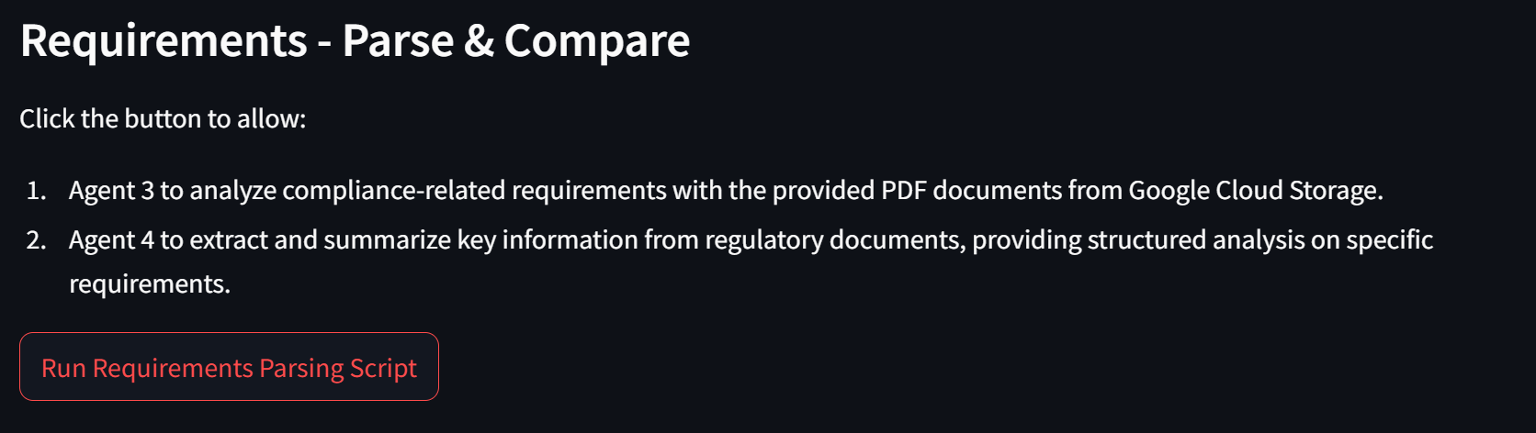
Mock Up
https://aianalyser.streamlit.app/

Slide 14
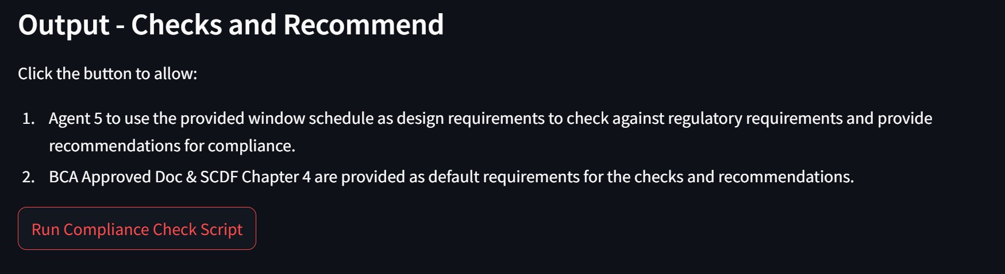
Mock Up
https://aianalyser.streamlit.app/

Slide 15
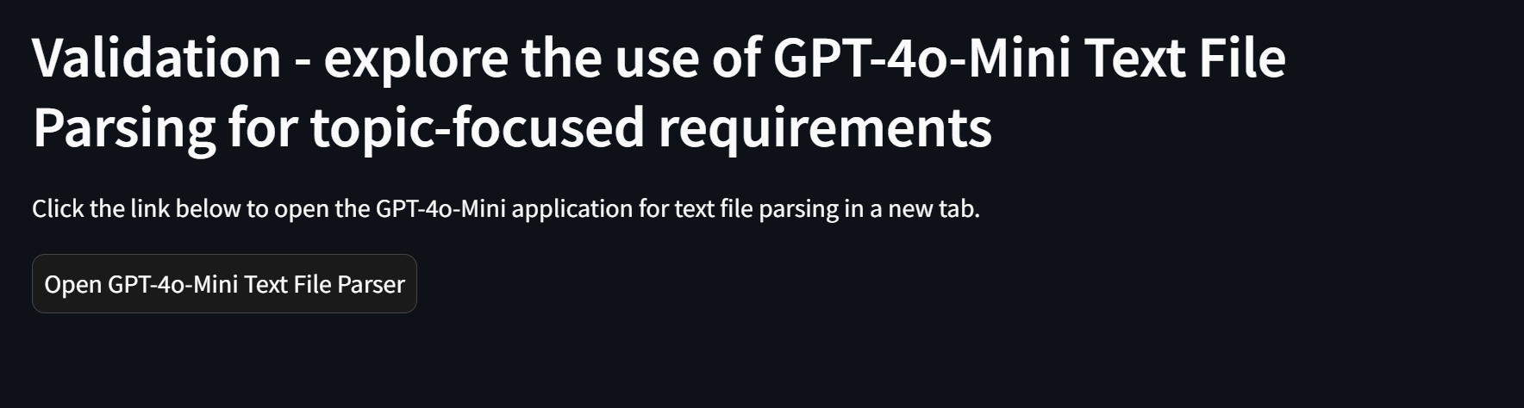
Mock Up
https://aianalyser.streamlit.app/

Slide 16
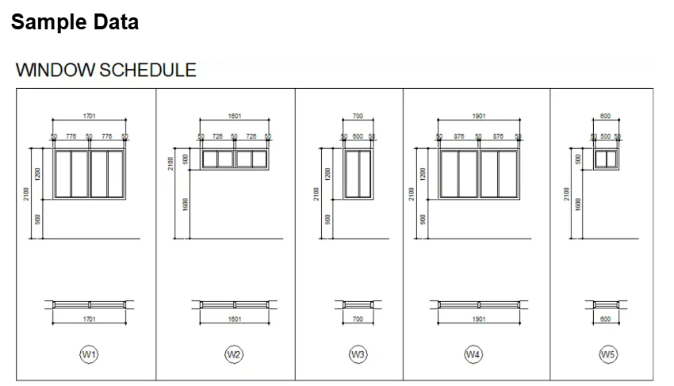
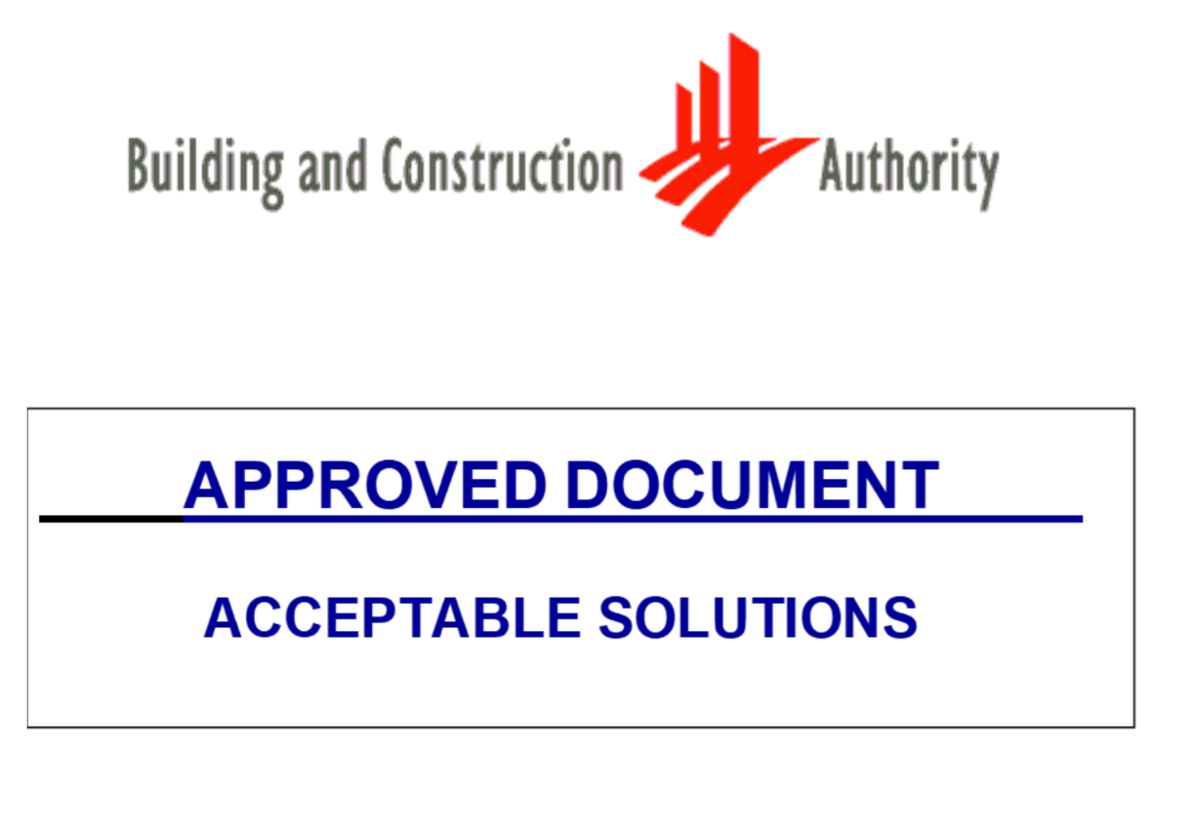
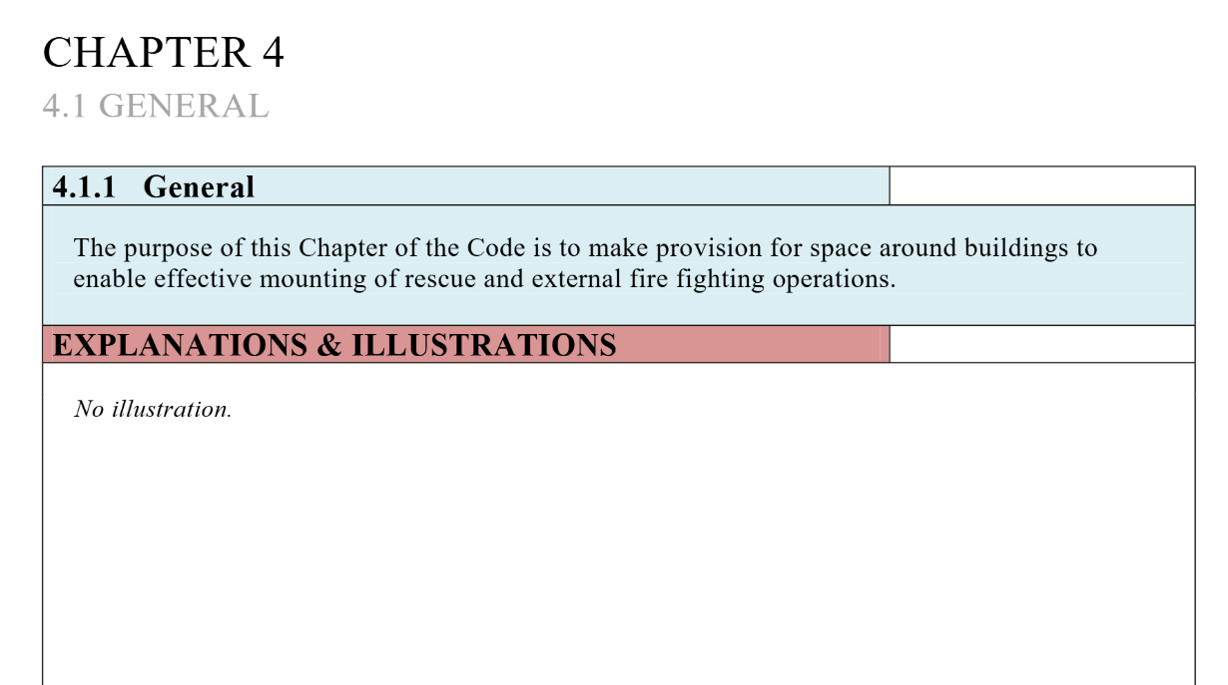
Sample Data Used

Slide 17
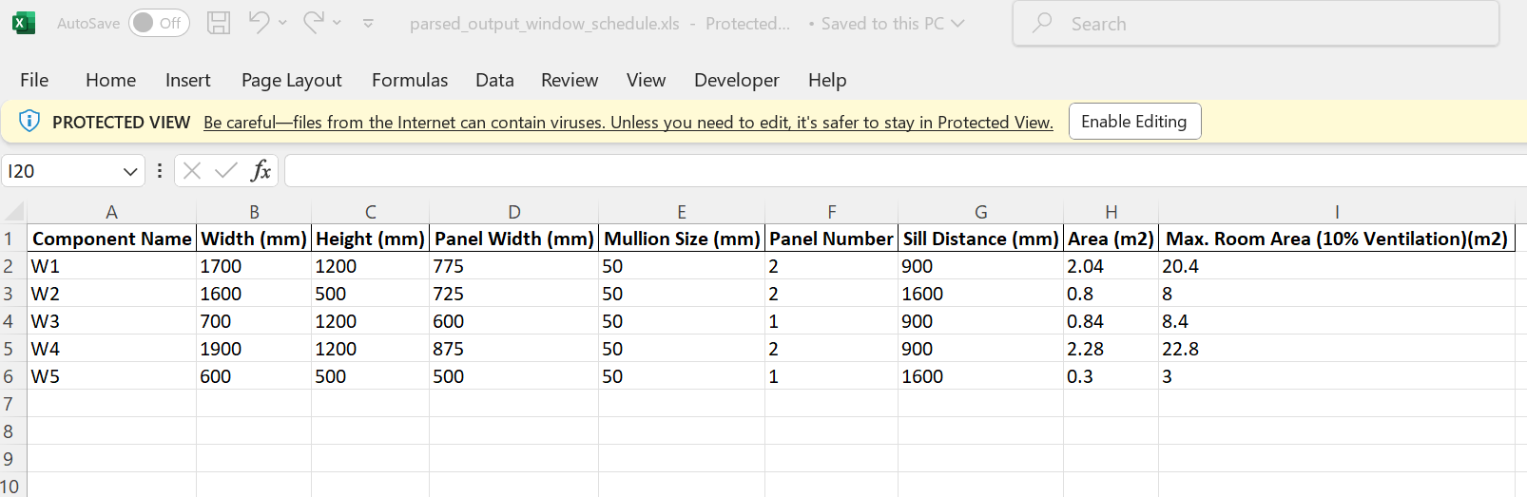
Outcome – Tabulated Measurable Data
https://storage.cloud.google.com/data_parsing/parsed_output/window_schedule.xls

Slide 18
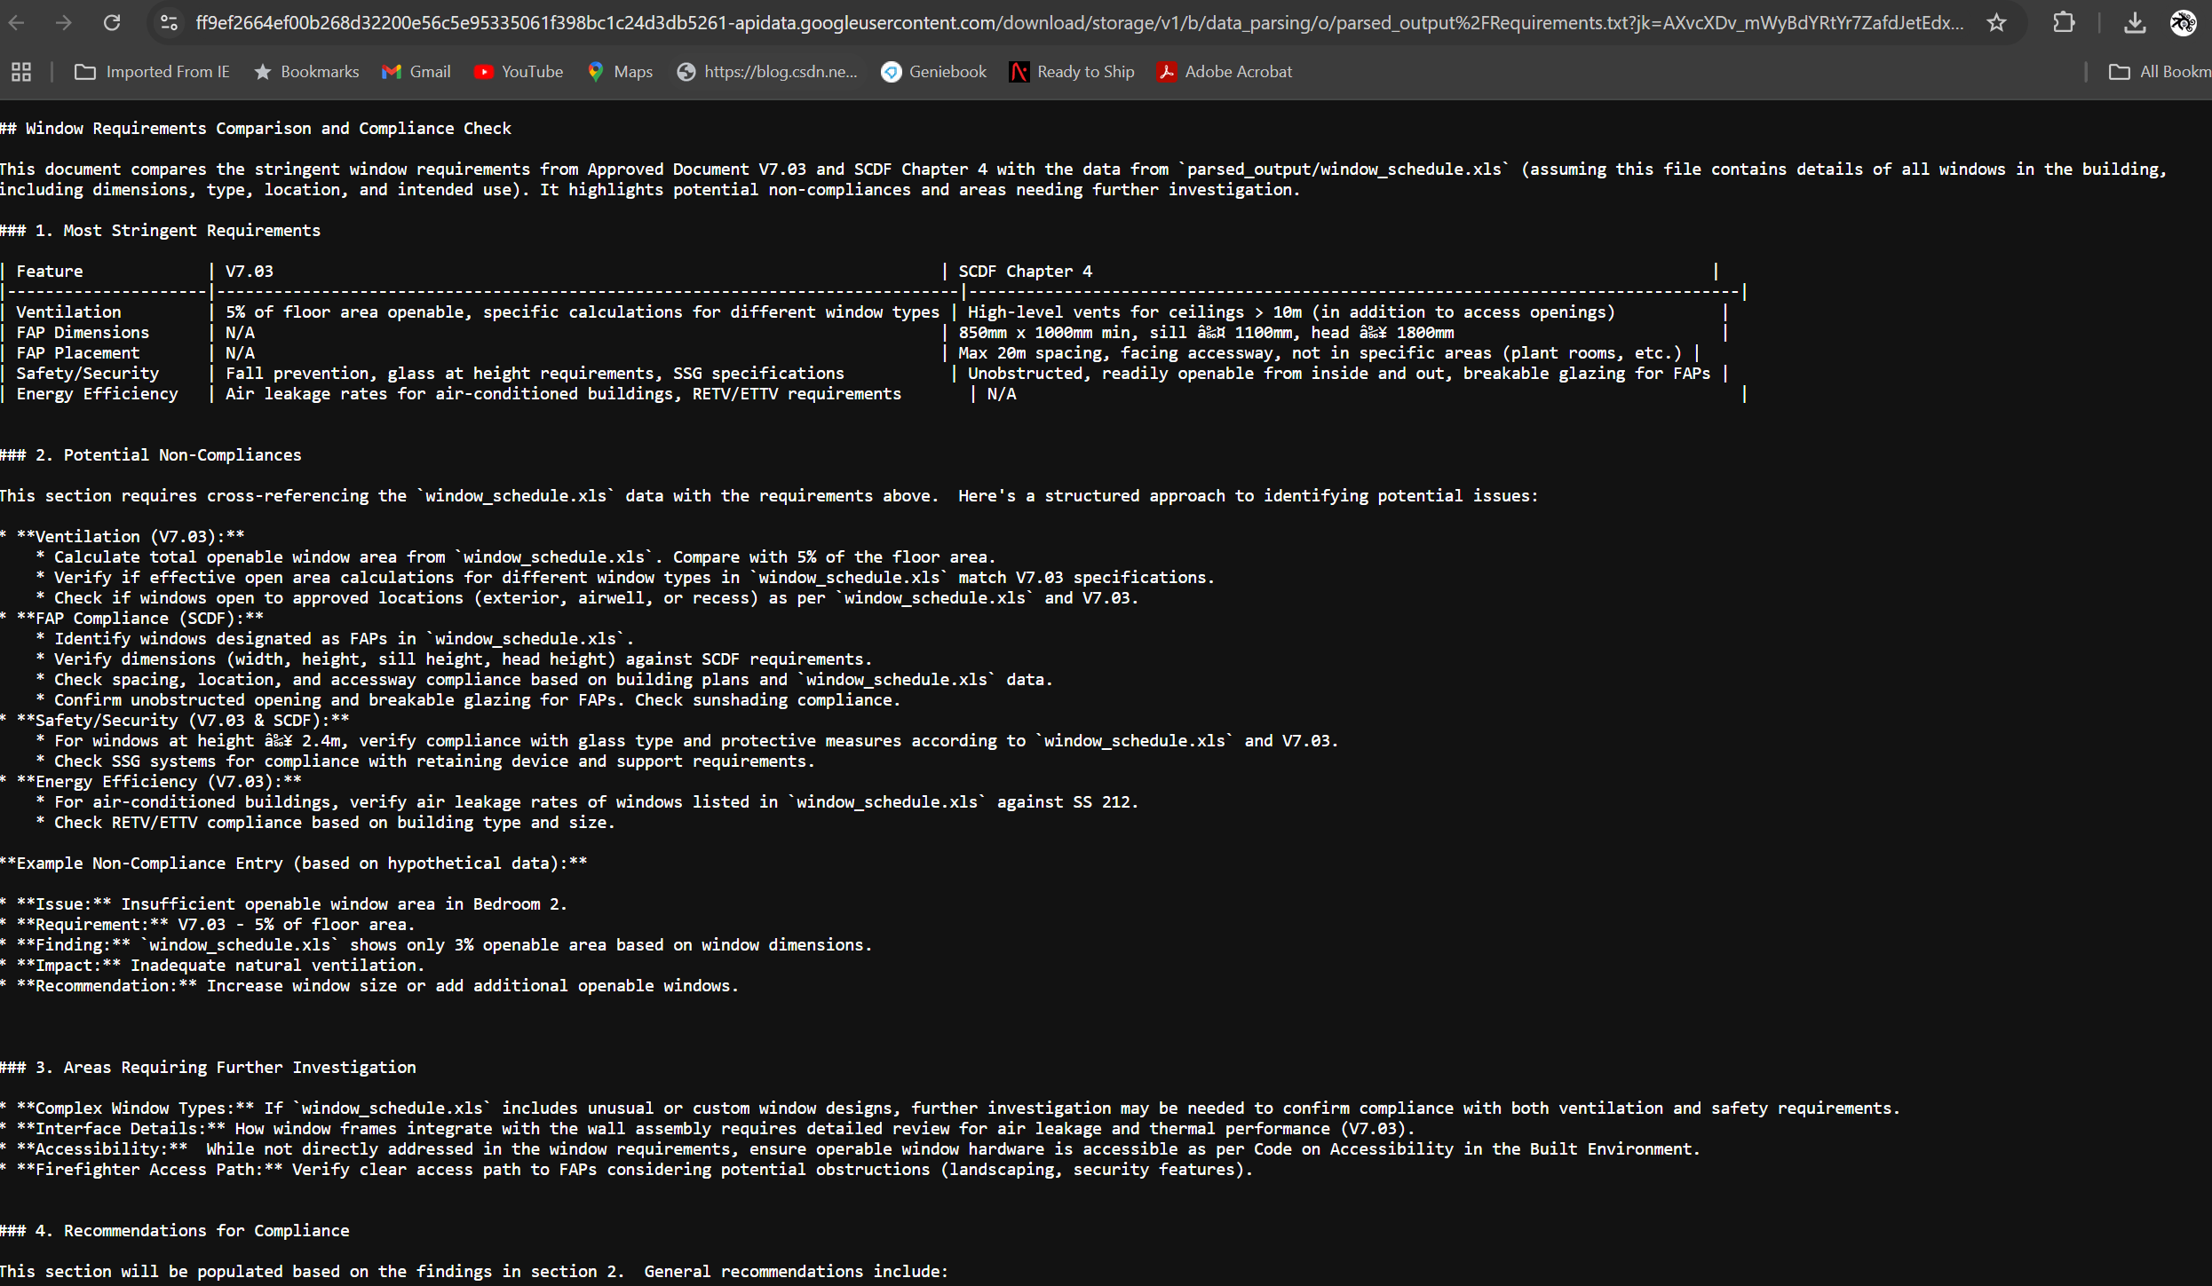
Outcome – Parsed Requirements
https://storage.cloud.google.com/data_parsing/parsed_output/Requirements.txt

Slide 19
Outcome – Parsed Requirements
https://storage.cloud.google.com/data_parsing/parsed_output/Requirements.txt

Slide 20
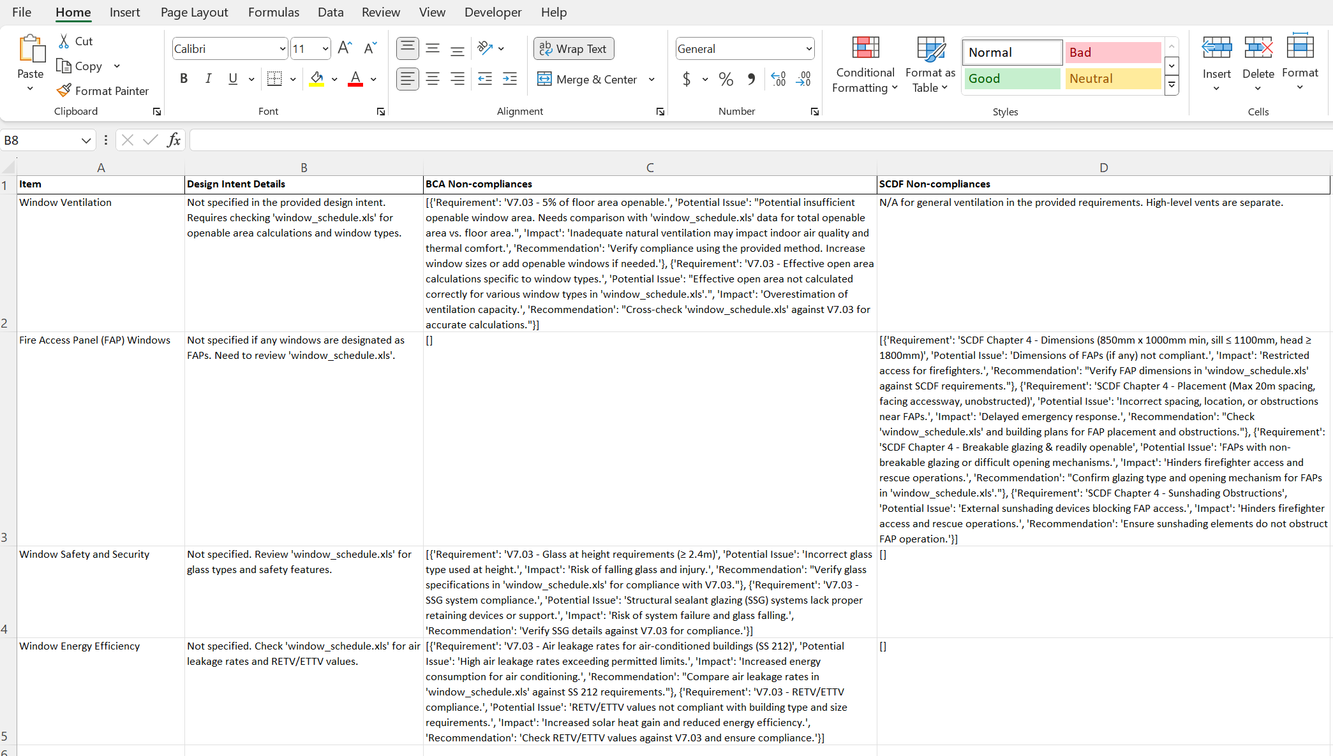
Outcome – Highlighted non-compliances concerns
https://storage.cloud.google.com/data_parsing/parsed_output/check_1.xlsx

Slide 21
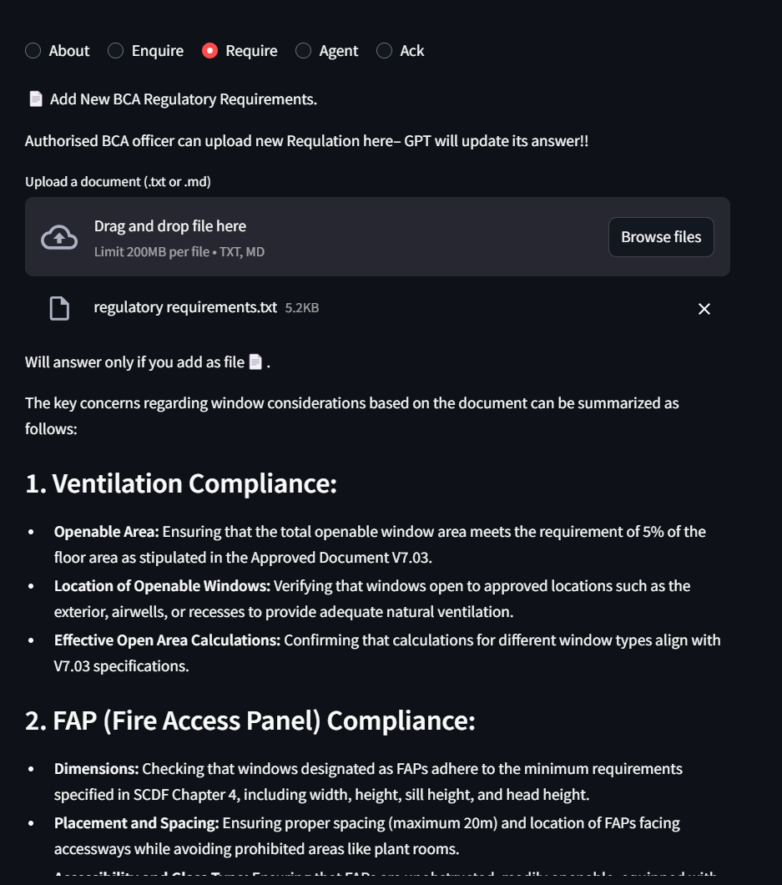
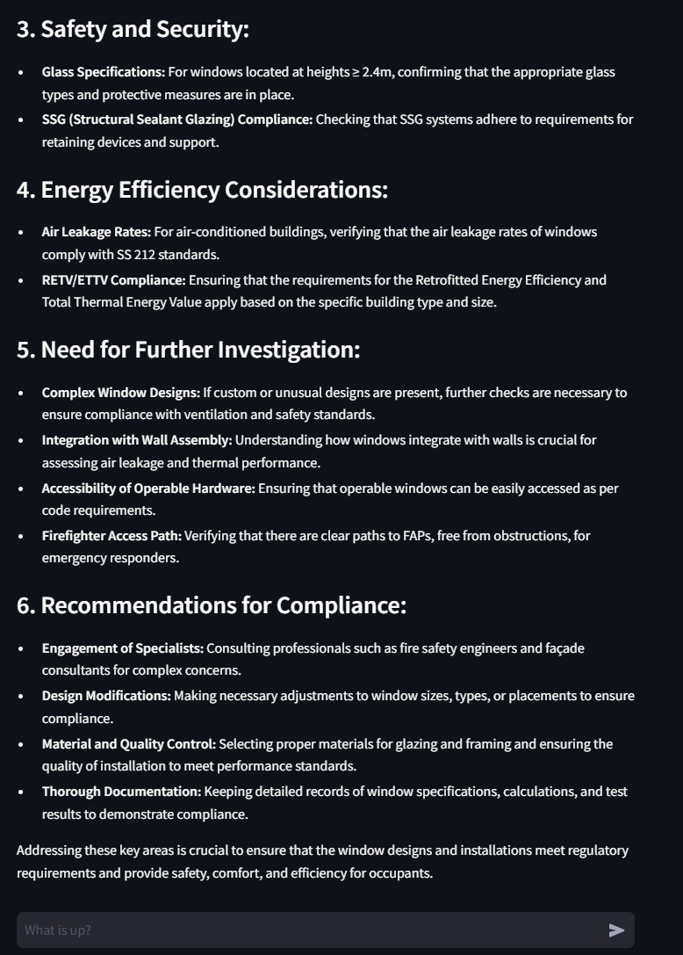
Outcome – Validations (Independent Agent)
https://bca-project.streamlit.app/

Slide 22

Learning Points (from Obstacles)
Functionality & User Experience:
Engaging different models to replace parsing functions,
Limited time for quick learning while doing approach,
Engage Govtech provided guides and advice.
Technical Implementation:
Proper use of Vertex AI tools,
Comparisons of different tools,
Prompt Engineering techniques for effective outcomes.
Innovation:
Implement AI Agentic workflow to streamline programming processes and
Automating actual practice processes using LLM with user interactive approach.
Documentation:
Plays an important role to learn, relearn and
Share information for teamwork, collaboration and coordination.

